Slide 1

PROGRESS REPORT FOR FINAL YEAR PROJECT “Data Concealment using LSB substitution techniques”
TEAM |  | FACULTY
Mr. Gaurav Walia | Mr. Himalaya Monga | Mr. Sanjiv Kumar Tomar
E.No.: A2305208370 Class - 8CS3 | E.No. : A2305208372 Class – 8CS3 | Senior Lecturer
B.Tech (CS&E) 08-12 | B.Tech (CS&E) 08-12 | ASET, AUUP

Slide 2
Application Features
Features of the application:
Concealing Plain text in an Image File.
Concealing Plain text in an Audio FIle.
Concealing Image in an Image File.
Concealing Image in an Audio File.
Concealing Audio in an Image File.
Concealing Audio in an Audio File.
Added Features:
Dynamic File Compression
Password Encryption for compressed files

Slide 3
Project Summary
Implement and demonstrate an interactive interface for multiple parties to share confidential data (Messages, Images & Audio) in a hidden shell using the techniques of LSB substitution
The advantage of such an application is, that the data is not only encoded and sent to the user, but also sent in a hidden shell so as to reduce doubts of suspicion.
The encoded file, inherently has an increased file size, therefore efficient algorithms for file compression are to be applied.

Slide 4
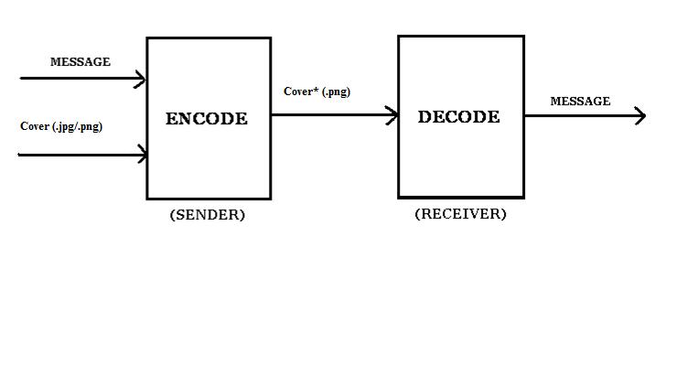
Block Diagram

Slide 5
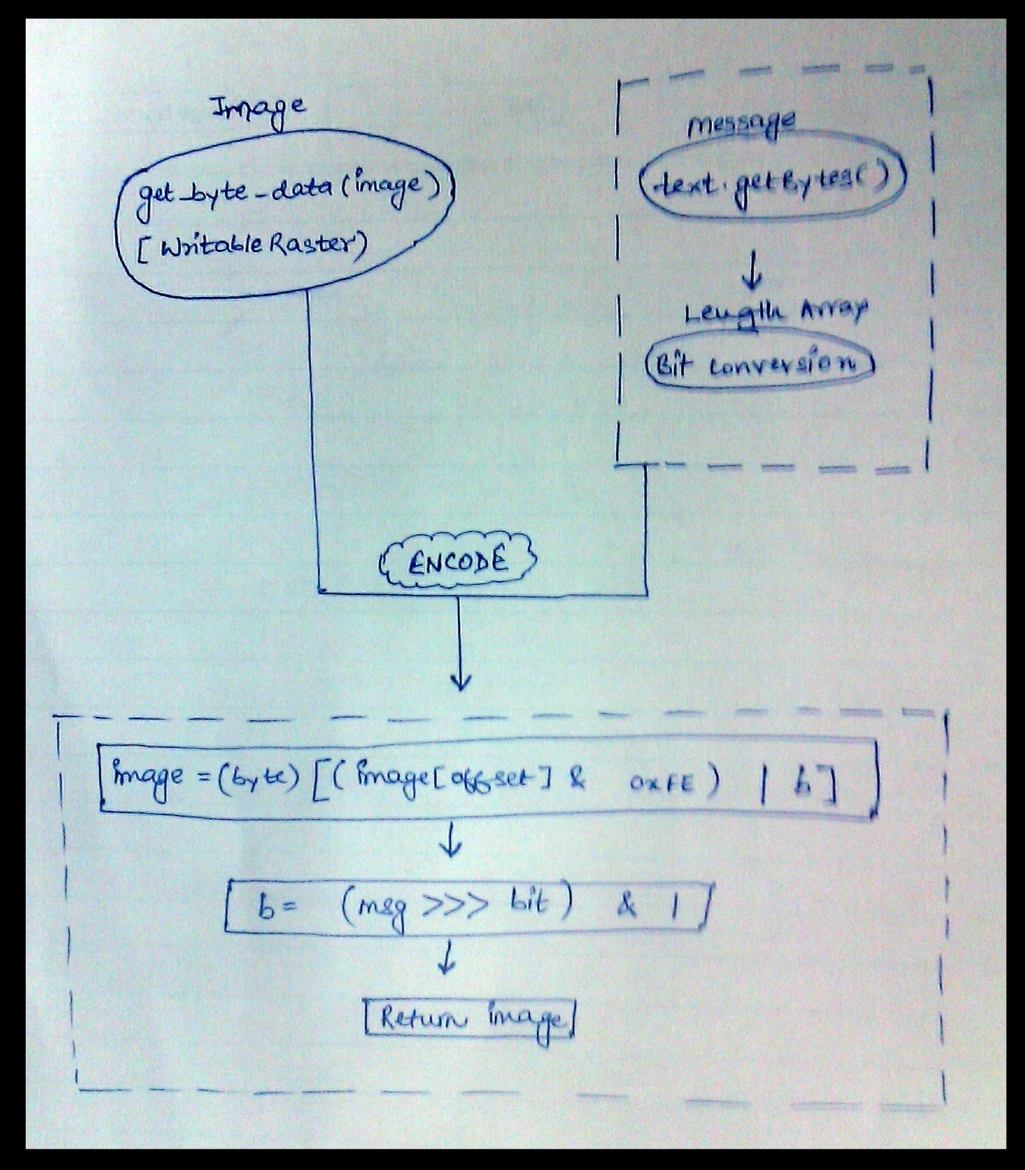
Basic Flow Chart

Slide 6
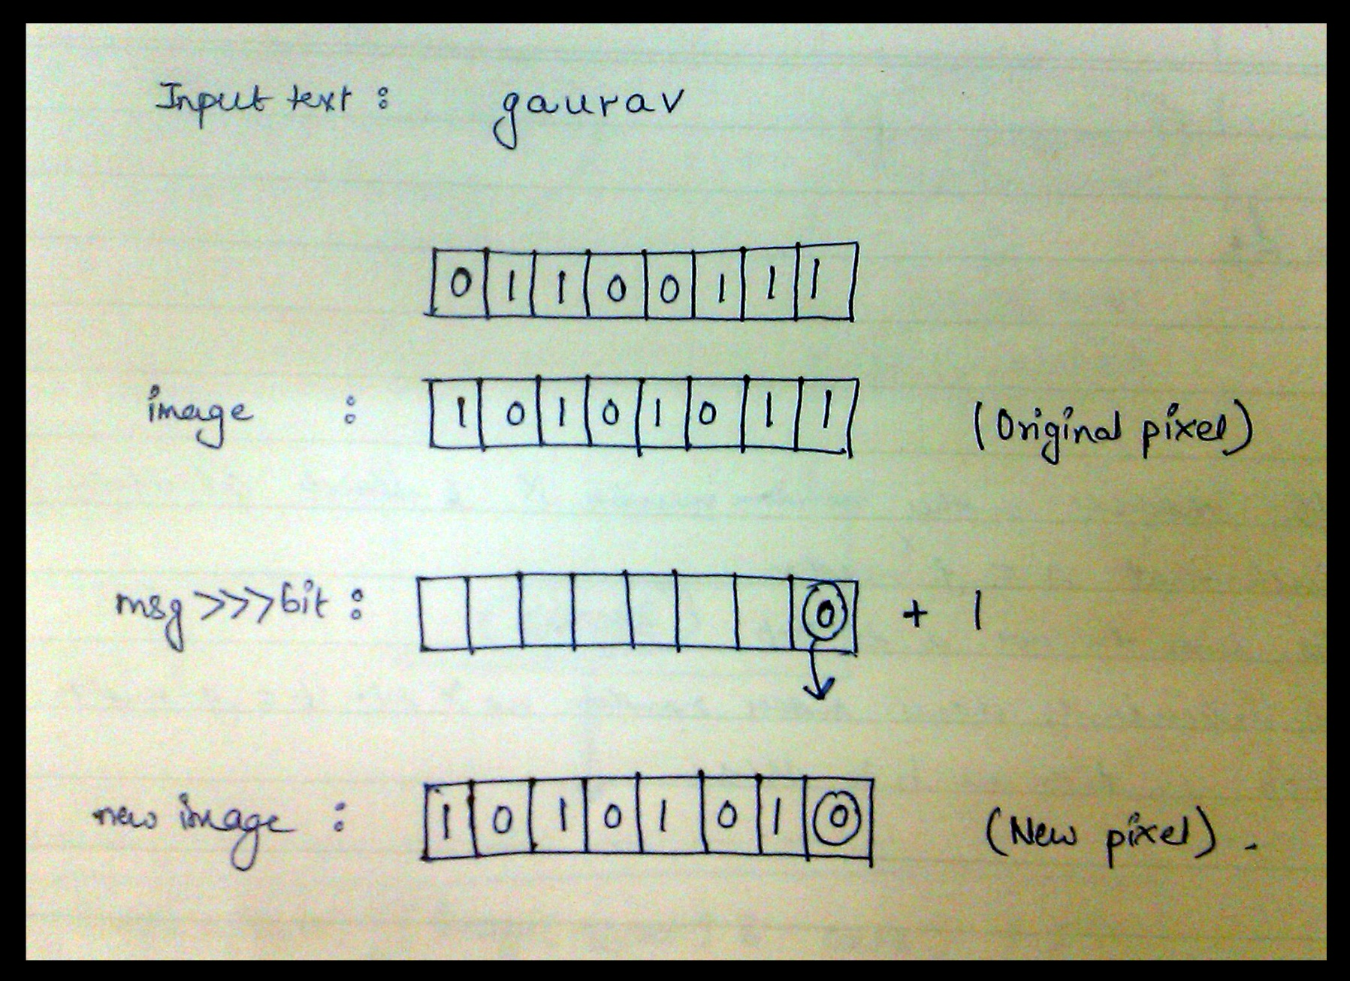
Internal Working

Slide 7
Implementation so far :
Concealment of plain text messages in an image, has been successfully implemented.
This being an initial (though, crucial) part of the project, enables us to easily code the further modules.
We plan to complete the project by the next presentation, with all modules as specified in the project features.

Slide 8
HOW?
Firstly, the text to be encoded is taken from the user.
Then, an option of selecting an image of his choice is given.
After the selection, the bit array of the image is extraced using WritableRaster.class
Meanwhile, the bit array of the text is also extracted using text.getBytes(), and the length is calculated.
Finally, each bit of the characters in the text, is encoded with the LSB of the bytes in the image.
The above step takes place with the help of ‘Bit Shifting’ and ‘AND Operation’.

Slide 9
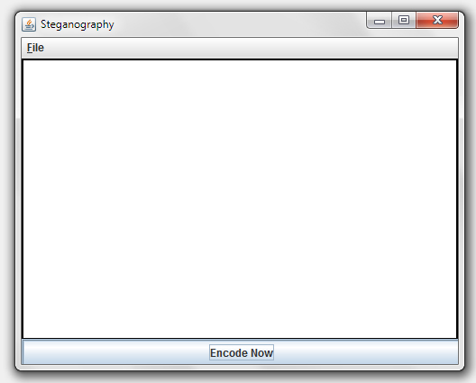
SNAPSHOTS

Slide 10
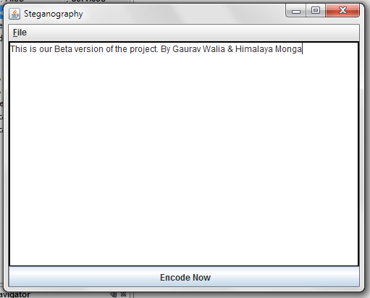

Slide 11
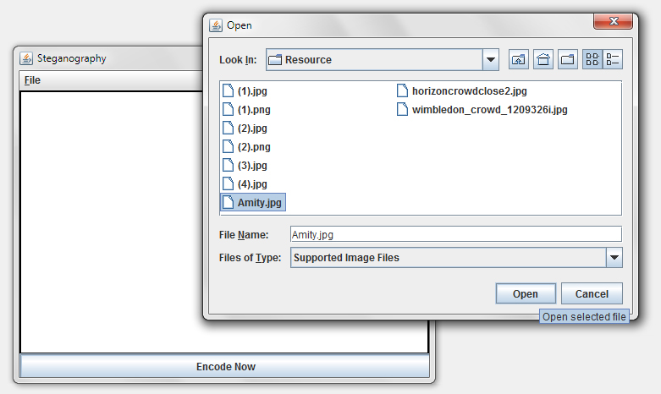

Slide 12
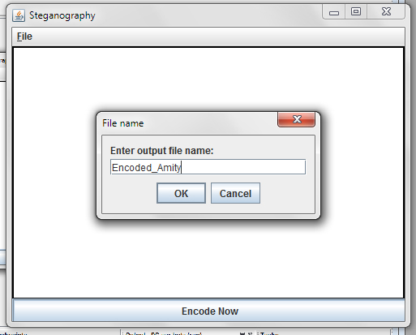

Slide 13
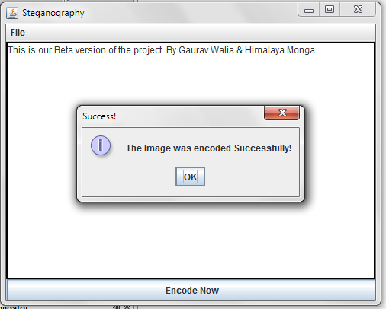

Slide 14
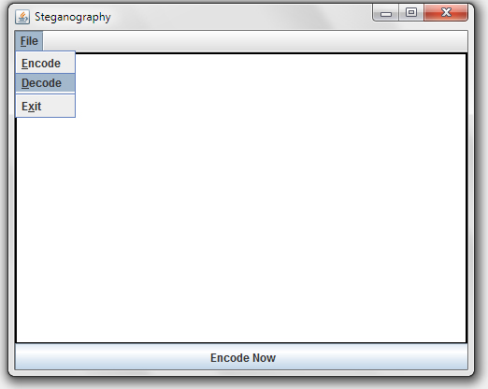

Slide 15
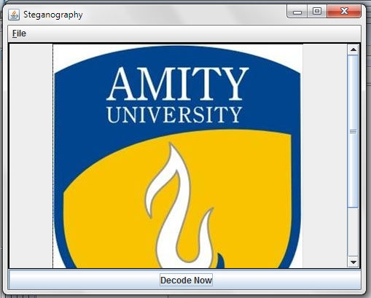

Slide 16
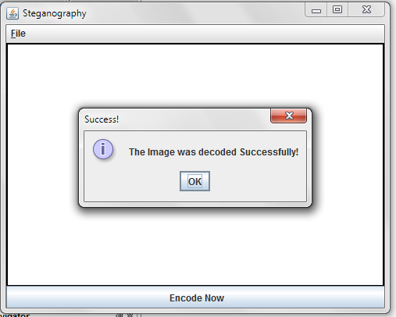

Slide 17
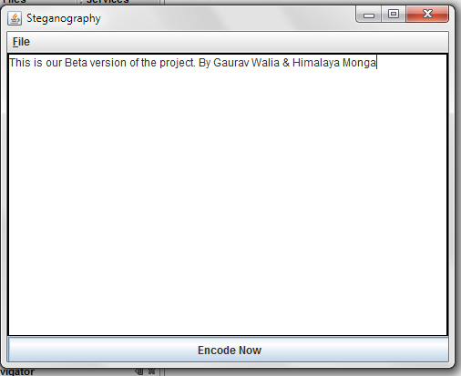

Slide 18
THANK YOU

